Slide 1
IR Models - Boolean

Slide 2
Retrieval models
exact-match and best-match retrieval
Exact-match
query specifies precise retrieval criteria every document either matches or fails to match query
result is a set of documents
Best-match
query describes good or “best” matching document
result is ranked list of documents
result may include estimate of quality
Best-match models: better retrieval effectiveness
good documents appear at top of ranking
but efficiency is better in exact match (e.g., Boolean)

Slide 3
Information Retrieval models
Boolean model - exact match
Statistical models - best match
Vector Space model
Probabilistic model
Language models - best match

Slide 4
Boolean Model
Boolean model is arguably the simplest model to base an information retrieval system on.
Query is in the form of a Boolean expression of terms - terms are combined with the operators AND, OR, and NOT.
Primary commercial retrieval tool for 3 decades
Many search systems you still use are Boolean: Email, library catalog, Mac OS X Spotlight, WestLaw- legal SE
The model views each document as just a set of words – presence/absence of words in documents
Is precise: Document matches condition or not
Representation – TD matrix ?

Slide 5
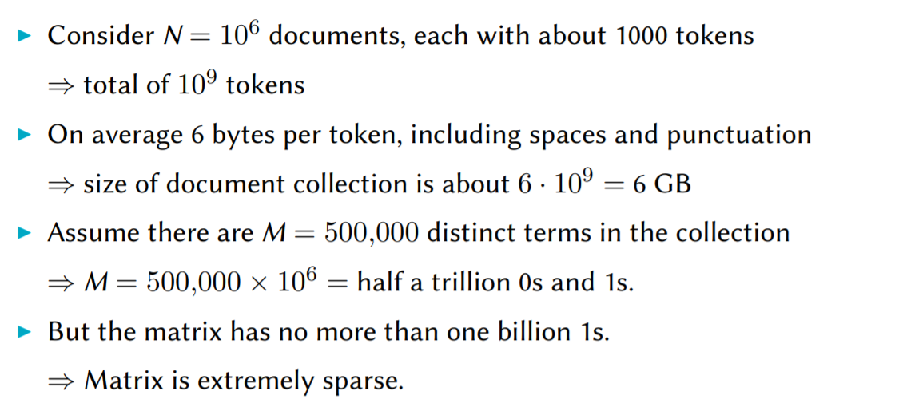
Big data

Slide 6
Observation
Term-document matrix is very sparse
Contains no more than one billion 1s.
Better representation: only represent the things that do occur
Term-document matrix has other disadvantages, such as lack of support for more complex query operators (e.g., proximity search)
Inverted Index

Slide 7
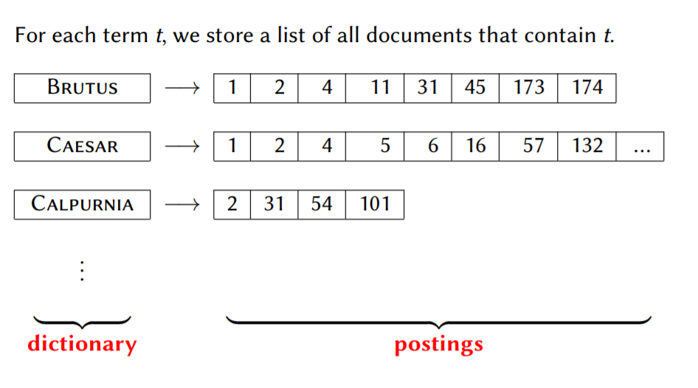
Inverted index
Sec. 1.2

Slide 8
Inverted index
Sec. 1.2
We need variable-size postings lists
In memory, can use linked lists or variable length arrays
Posting
Brutus
1
2
4
11
31
45
173
174
Caesar
1
2
4
5
6
16
57
132
Calpurnia
2
31
54
101
Dictionary
Postings
Notes:
Linked lists generally preferred to arrays
Dynamic space allocation
Insertion of terms into documents easy
Space overhead of pointers

Slide 9

Inverted index construction
Sec. 1.2
Documents to
be indexed
Friends, Romans, countrymen.
Tokenizer
Token stream
Friends
Romans
Countrymen
Linguistic modules
Modified tokens
friend
roman
countryman
Indexer
friend
2
4
roman
1
2
Inverted index
countryman
13
16
Notes:
Document icons from free icon set: http://www.icojoy.com/articles/44/

Slide 10
Initial stages of text processing
Tokenization
Cut character sequence into word tokens
Normalization
Map text and query term to same form
U.S.A. and USA to match
Stemming
different forms of a root to match
authorize, authorization
Stop words
omit very common words (or not)
the, a, to, of

Slide 11
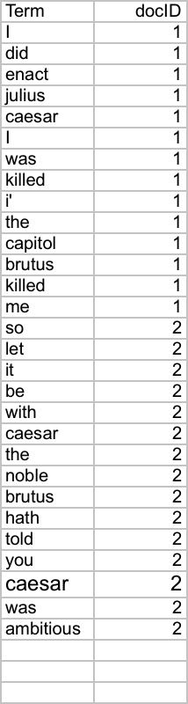
Indexer steps: Token sequence
Sec. 1.2
Sequence of (Modified token, Document ID) pairs.
Doc 1
Doc 2
I did enact Julius
Caesar I was killed
i’ the Capitol;
Brutus killed me.
So let it be with
Caesar. The noble
Brutus hath told you
Caesar was ambitious

Slide 12
Indexer step: Sort
Sec. 1.2

Slide 13
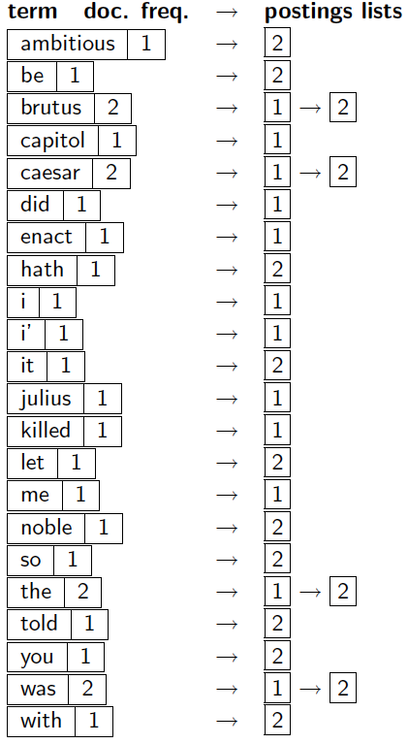
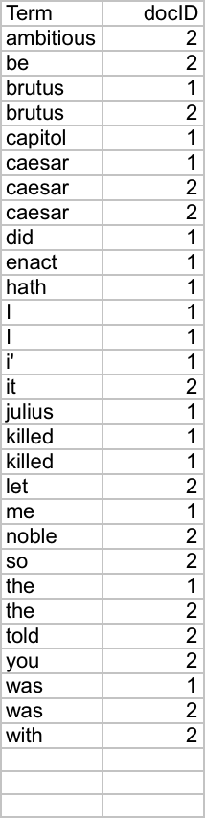
Indexer steps: Dictionary & Postings
Sec. 1.2
Doc. frequency information is added

Slide 14
Query processing: AND
Sec. 1.3
Consider processing the query:
Brutus AND Caesar
Locate Brutus in the Dictionary;
Retrieve its postings
Locate Caesar in the Dictionary;
Retrieve its postings.
Merge” the two postings:
2
4
8
16
32
64
128
Brutus
1
2
3
5
8
13
21
34
Caesar

Slide 15
The merge
Sec. 1.3
Walk through the two postings simultaneously, in time linear in the total number of postings entries
2
2
4
4
8
8
16
16
32
64
128
32
64
128
Brutus
2
8
1
Caesar
1
2
2
3
5
5
8
8
13
13
21
21
34
3
34

Slide 16
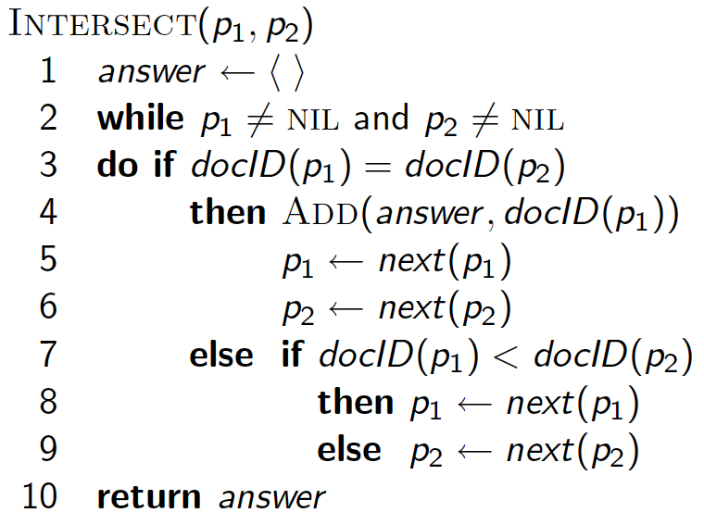
Intersecting two postings lists (a “merge” algorithm)

Slide 17
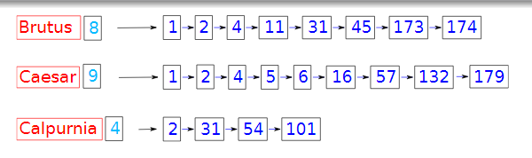
Conjunctive Query – Multiple terms Query Optimisation
Brutus AND Caesar AND Calpurnia
order of execution ??
Process terms in increasing document frequency
(Calpurnia AND Brutus) AND Caesar

Slide 18
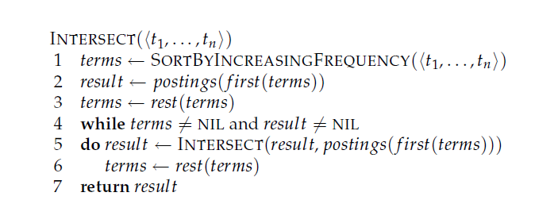
Algorithm for conjunctive queries

Slide 19
OR queries
text OR data OR image
• The terms can be processed simultaneously: when merging inverted lists, documents are included only once
– text: <8; 1, 4, 8, 12, 16, 20, 21, 30>
– data: <12; 2,4,7,8,10,12,13,15,19,20,21,28>
– image: <5; 4,5,9,11,12>
• answer: <18;1,2,4,5,7,8,9,10,11,12,13,15,16,19,20,21,28,30>

Slide 20
More general queries
• All Boolean queries can be transformed into a conjunction of disjunctions
• ”(information AND (retrieval OR indexing)) OR ((text OR data) AND (compression OR compaction))”
•”(information OR text OR data) AND (retrieval OR indexing OR text OR data) AND (information OR compression OR compaction) AND (retrieval OR indexing OR compression OR compaction)”
(A and B) or (C and D) = (A or C) and (B or C) and (A or D) and (B or D)

Slide 21
‘Not’ Queries
NOT queries cannot be on their own, they are actually AND NOT queries
• ”text AND NOT data”
– text: <8; 1, 4, 8, 12, 16, 20, 21, 30>
– data: <12; 2,4,7,8,10,12,13,15,19,20,21,28>
• We first compute ”text AND data”
– <4,8,12,20,21>
• We merge the inverted lists of the term ”text” and ”text AND data” in such a way that we remove documents that appear in both lists – <1,16,30>

